Slide 1
Azure container service
Running containers in Azure

Slide 2
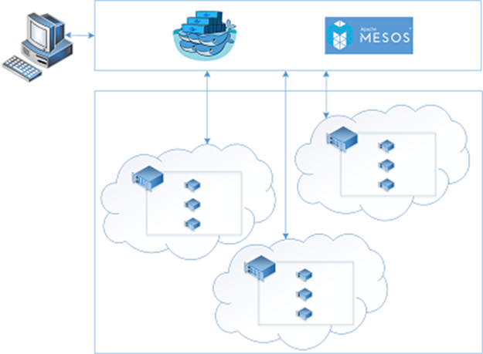

Azure container service
Easy create, configure and manage a VM cluster
DC/OS or Docker Swarm
Standard Docker-API
Up to 5 Master and 100 Agents
VMs from 0.25 Cores 0.75GB RAM to 32 Cores and 448GB RAM (per agent)

Slide 3
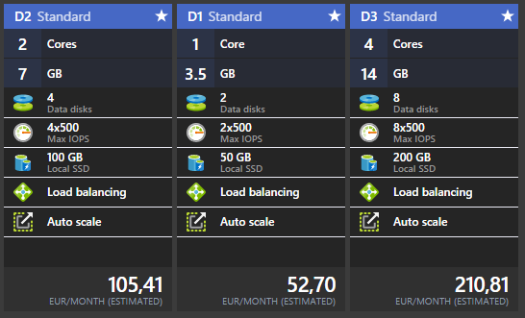
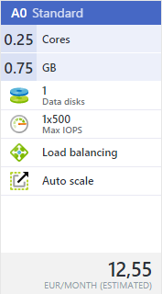
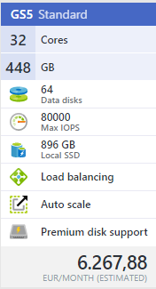
Azure container service Costs (recommended)

Slide 4
Azure Portal

Slide 5
Azure container service
https://azure.microsoft.com/en-us/documentation/articles/container-service-intro/
https://azure.microsoft.com/en-us/documentation/videos/connect-2015-getting-started-developing-with-docker-and-azure-container-service/
https://azure.microsoft.com/en-us/documentation/videos/azurecon-2015-deep-dive-on-the-azure-container-service-with-mesos/
https://docs.docker.com/swarm/overview/
https://dcos.io/
https://www.docker.com/

